Slide 1

ADVANCED DATA VISUALISATIONS TECHNIQUES USING AMAZON BOOKS DATSET

Slide 2
SECTION 1
Introduction: This comprehensive report provides insights into book genres, pricing trends, and author impacts by utilizing advanced analytics and visualization, we find out the contents of the dataset, offering strategic perspectives for readers.
Link to Data: Amazon Books Dataset
Rationale for Choice: The dataset about Amazon products seems interesting as it contains diverse information such as product details, reviews, pricing, and categories. Analyzing this data could offer insights into customer preferences, and popular products, and potentially contribute to marketing strategies.

Slide 3
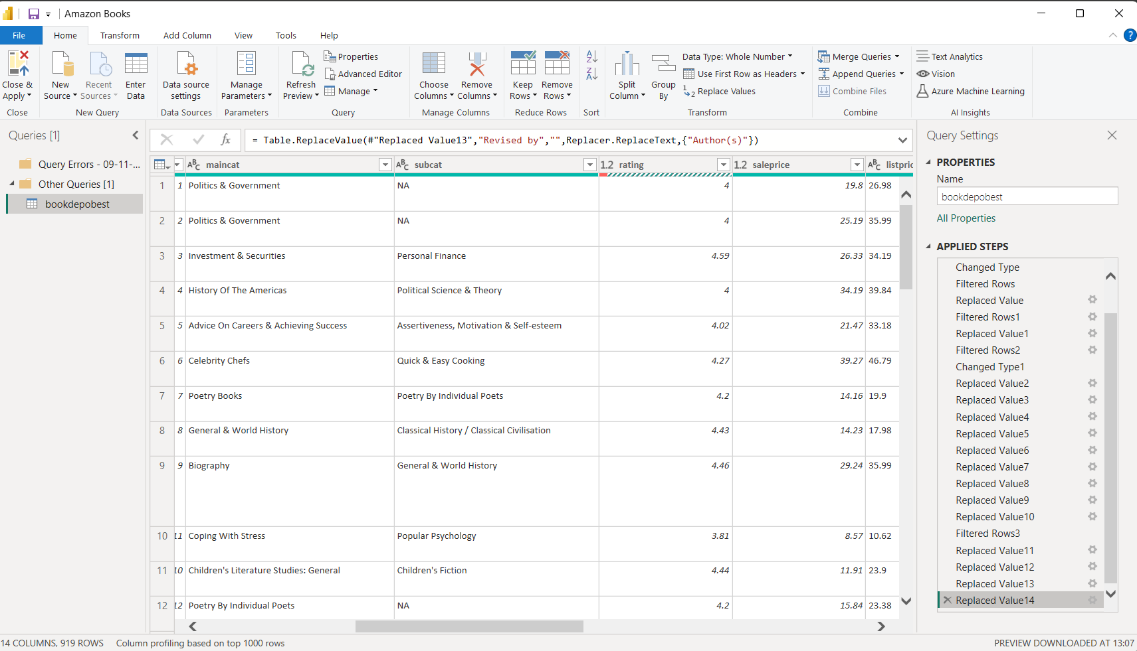
Handling Data Issues and Transformations:
Data Cleaning:
Missing Data: Identified missing data using queries in crucial columns such as ‘saleprice’, ‘maincat’, ‘authors’, ‘goodreadsratecount’, ‘list price’, and ‘rating’.
Handling Null Values:
Replaced and removed missing values cautiously to ensure the dataset's integrity.

Slide 4
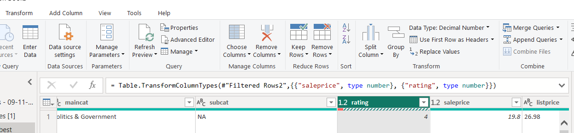
Data Transformation:
Convert Data Types: Converted string values to numerical formats for columns like ‘sale price’, ‘list price’, and ‘rank’, and converted string values into decimal numbers for the column ‘rating’. Ensured that data types are appropriate for analysis.
Also, Converted string-based columns ('datepub') to the date format.

Slide 5
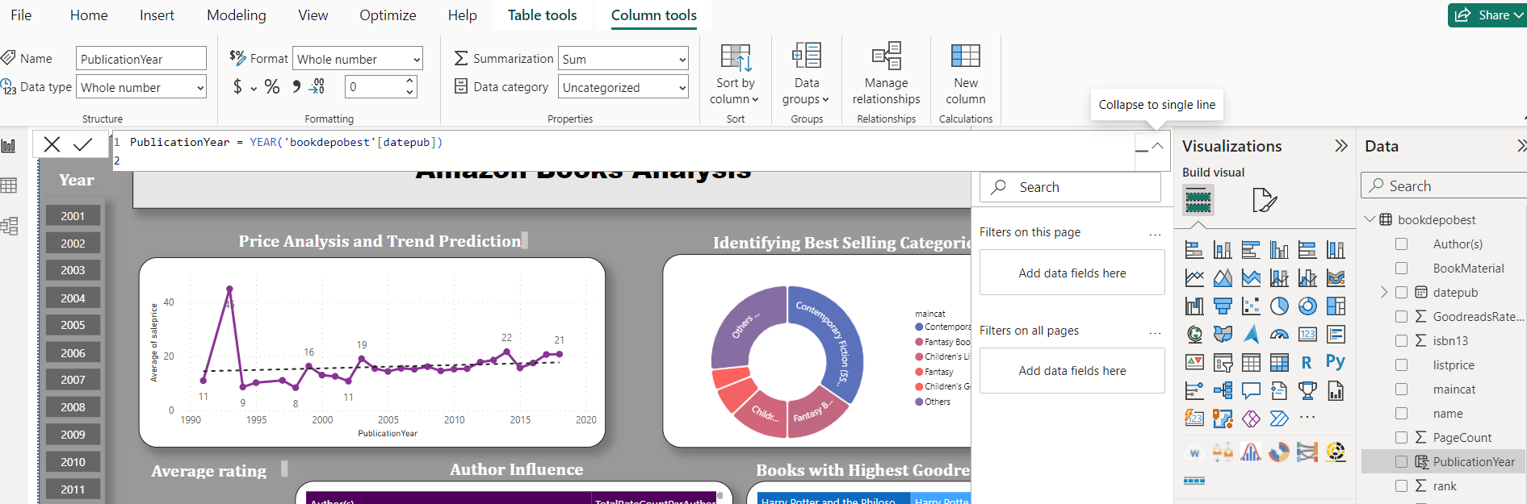
Feature Engineering:
Extracted useful features from existing data, such as the year from the publication date. By creating new column using DAX query: “PublicationYear = YEAR('bookdepobest'[datepub])” Normalization:
Normalized numerical data ('saleprice', 'listprice') for better analysis using DAX query: “ScaledListPrice = (bookdepobest[listprice] - MIN(bookdepobest[listprice])) / (MAX(bookdepobest[listprice]) - MIN(bookdepobest[listprice]))”.

Slide 6
Selected Advanced Data Analytics Technique/Visual
Investigative Questions:
Identify Bestselling Categories:
Analysis Method: Use Power Query and DAX expressions for aggregating total reviews or Goodreads rate count by the main category.
Price Analysis and Trend Prediction:
Analysis Method: Trendlines to analyze price trends over publication years.
Author Influence:
Analysis Method: Clustering techniques or Decision Tree in Power BI to categorize or segment authors based on ratings, rate counts, or sales.

Slide 7
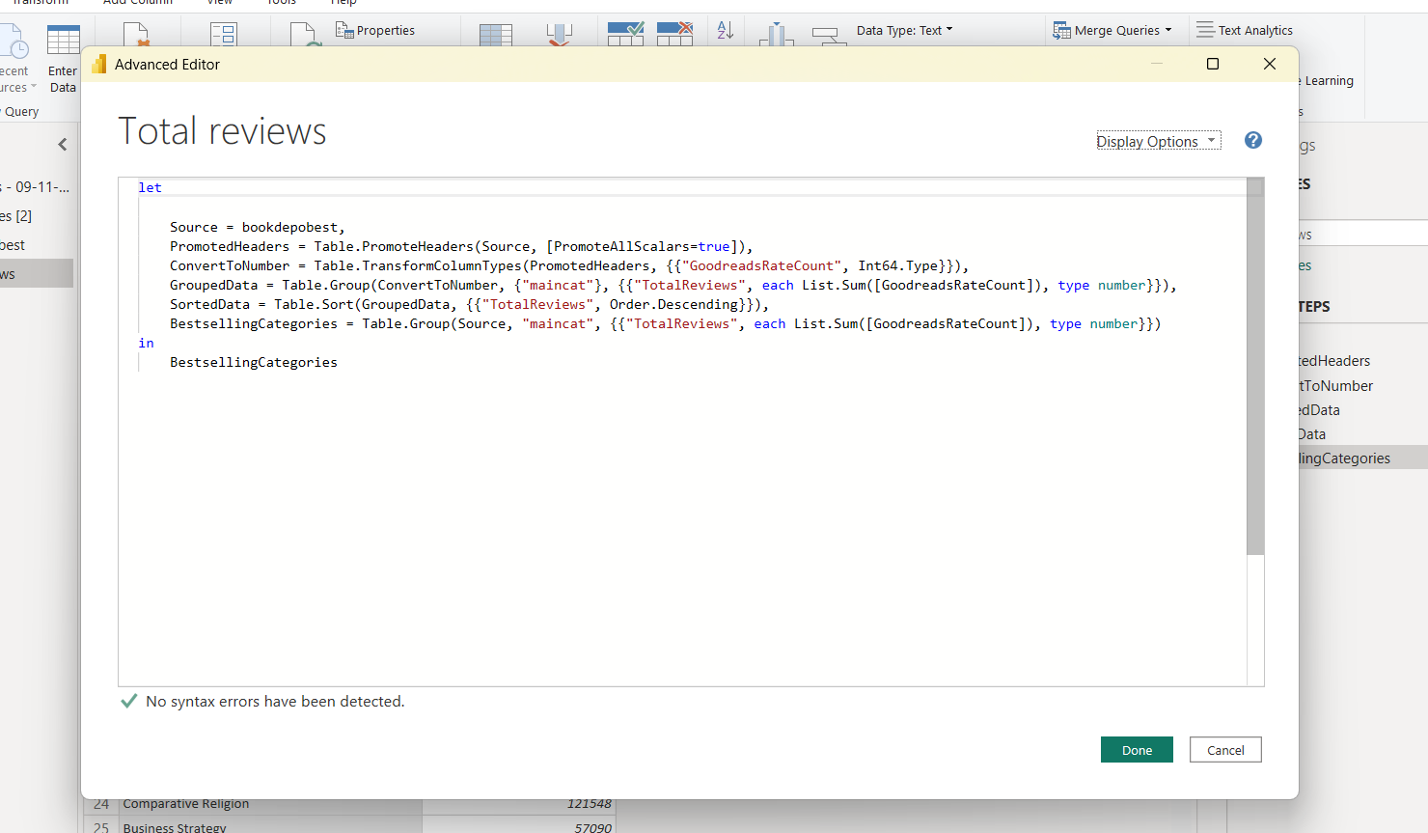
Identify Bestselling Categories:
Analysis Method: Use Power Query and DAX expressions for aggregating Goodreads rate count by the main category.
Used this query to group the dataset by the main category, calculate the total reviews for each category, sort the data in descending order based on total reviews, and then select the top category as the bestselling category.

Slide 8
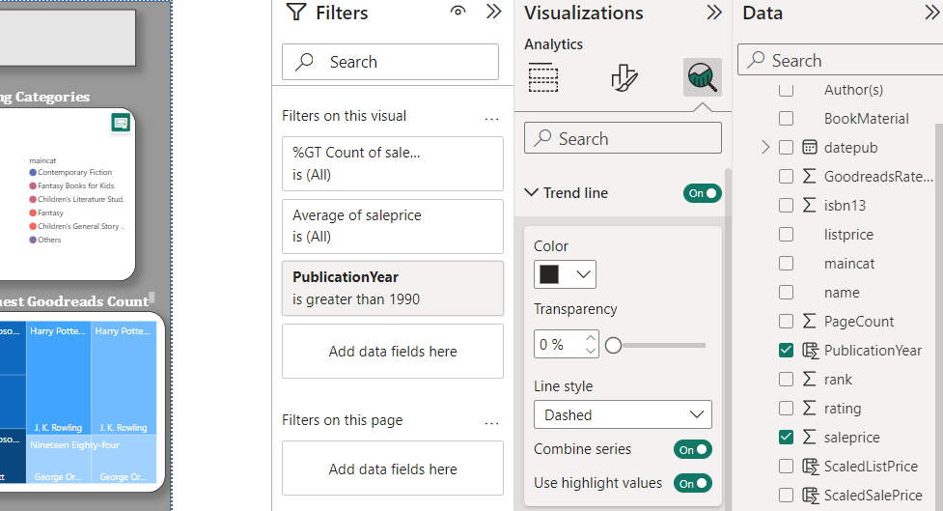
Price Analysis and Trend Prediction:
Analysis Method: Trendlines to analyze price trends over publication years.
Used the 'Analytics' pane to add a 'Trend Line' to the chart that display a trendline

Slide 9
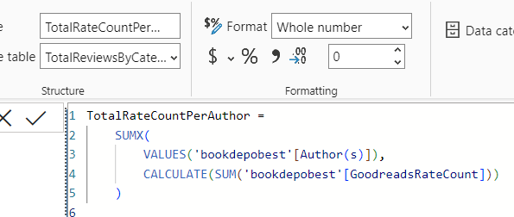
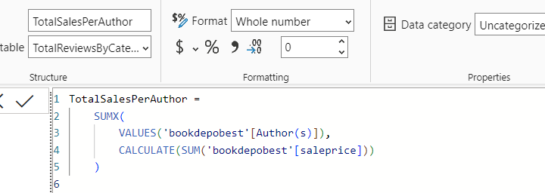
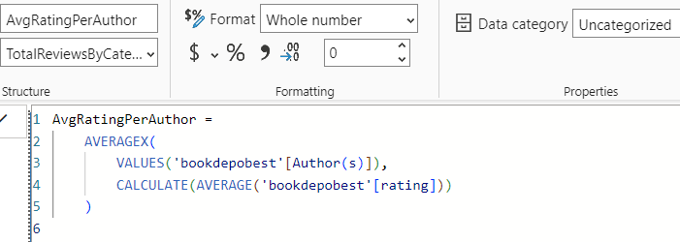
Author Influence:
Analysis Method: Clustering techniques to categorize authors based on ratings, rate counts, or sales. Used the following DAX Expression for Clustering Authors into new a table:
Total rate count per Author
Total sales per Author
Average rating per Author

Slide 10
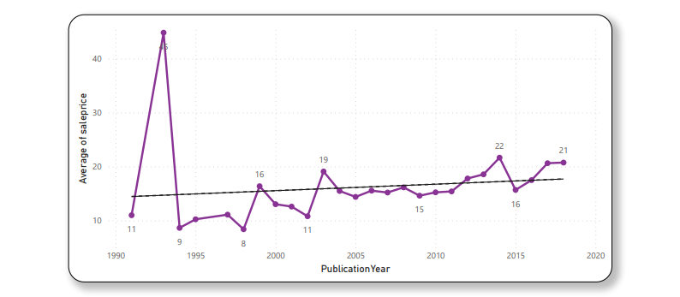
Section 3: Visualizations (Diagrams)
Price Analysis and Trend Prediction:
Objective: Analyze pricing trends over the years using the trend line method
Visualization: Line Chart with Trendline
﻿At 44.81, 1993 had the highest Average sale price and was 433.77% higher than 1998, which had the lowest Average sale price at 8.40.﻿﻿ Across all 26 Publication Years, the Average sale price ranged from 8.40 to 44.81.﻿﻿
Notes:
Line graph showcasing a steady price increase over the years, reaching approximately 30 in 2020.

Slide 11
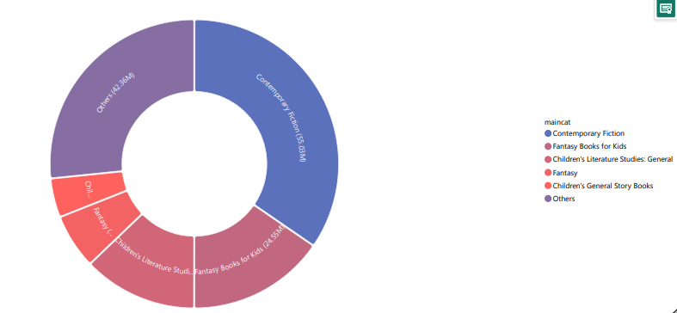
Bestselling Categories
Objective: Identify Bestselling Categories
Method: Power Query and DAX Expressions
Visualization: Sunburst Chart
Notes:
A pie chart highlights best-selling categories with sunburst visual, revealing that fiction, non-fiction, and children's books collectively contribute to over 80% of sales, emphasizing their popularity among customers.

Slide 12
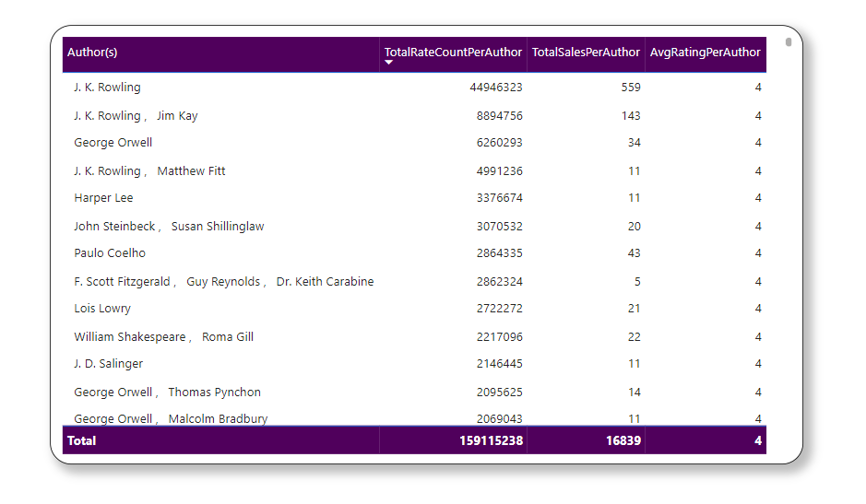
Author Influence
Objective: Identify the influence of authors
Method: Clustering Techniques
Visualization: Table
Notes:
This Table chart showcases author influence and books with the highest Goodreads count. Notable authors include J.K. Rowling, J.R.R. Tolkien, and George R.R. Martin, whose works stand out with the highest ratings and reviews.

Slide 13
Visualizations Overview
Line chart
Table chart
Top Authors by Total Rate Count:
J. K. Rowling: 44,946,323
J. K. Rowling Jim Kay: 8,894,756
George Orwell: 6,260,293
J. K. Rowling, Matthew Fitt: 4,991,236
Harper Lee: 3,376,674
Top Authors by Total Sale value:
J. K. Rowling: 559
J. R. R. Tolkien: 216
Brandon Sanderson: 208
Moleskine: 180
Lonely Planet: 179
Highest Average Sale Price:
Year 1993: 44.81
Lowest Average Sale Price:
Year 1998: 8.40

Slide 14
Visualizations Overview
Sun burst chart
Contemporary Fiction: 550.32M (Highest) - Strong engagement in contemporary fiction with over half a billion good reviews.
Fantasy Books for Kids: 245.54M - Robust reviews indicate high popularity in the fantasy genre for children.
Children's Literature Studies: General: 203.80M - Strong academic interest in children's literature studies reflected by millions of good reviews.
Fantasy: 98.14M - The fantasy genre maintains a substantial following with nearly 100 million good reviews.

Slide 15
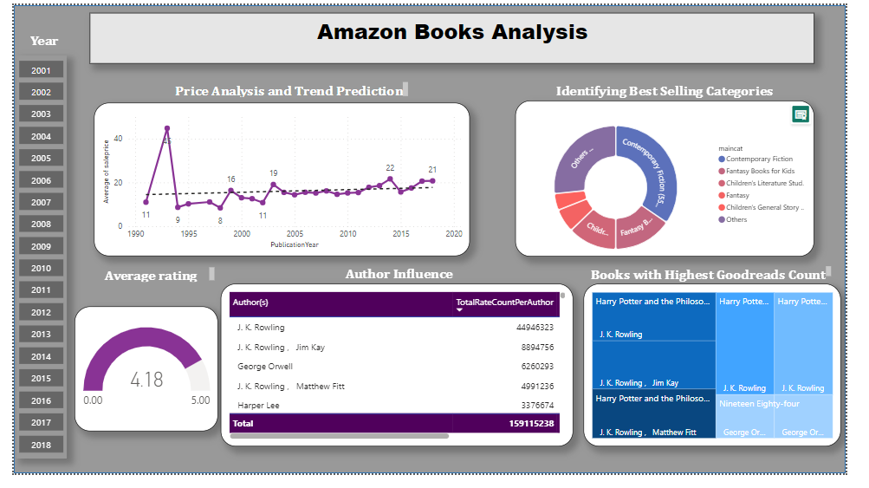
Dashboard
The dashboard provides valuable insights into pricing trends, popular book categories, customer satisfaction levels, and influential authors, aiding in strategic decision-making for the Amazon book market.
Notes:
The dashboard offers a comprehensive view of Amazon book sales, featuring price analysis and prediction through a line graph showcasing a steady price increase over the years.
A pie chart highlights best-selling categories, revealing that fiction, non-fiction, and children's books collectively contribute to over 80% of sales, emphasizing their popularity among customers.
Using a gauge chart, the dashboard depicts the average rating trend from 2001 to 2018, indicating fluctuation between 3.5 and 4.5 stars, with a slight recent decline.
The bottom right chart employs a table to showcase author influence and books with the highest Goodreads count. Notable authors include J.K. Rowling, J.R.R. Tolkien, and George R.R. Martin, whose works stand out with the highest ratings and reviews.

Slide 16
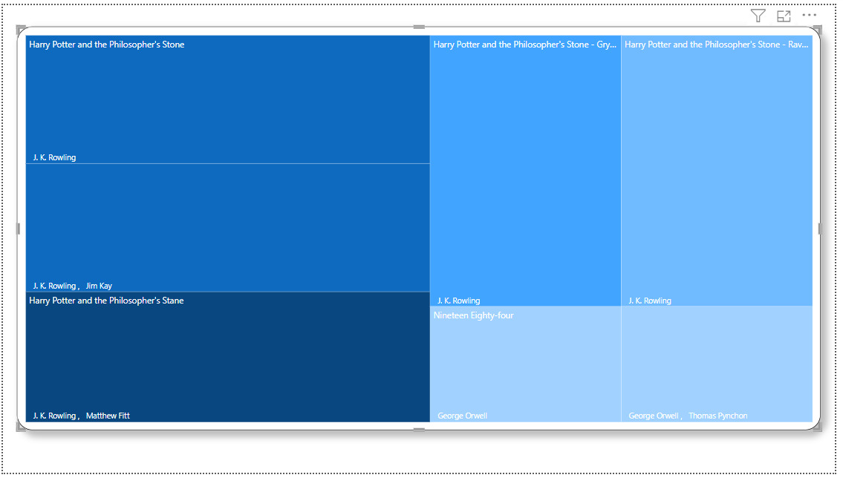
Tree map
The treemap visualization indicates that "Harry Potter and the Philosopher's Stone“ by J.K Rowling has the highest Goodreads RateCount with an impressive count of 4,991,236.
Notes:
"Harry Potter and the Philosopher's Stone" stands out with the highest Goodreads RateCount, indicating exceptional popularity.

Slide 17
Section4: Findings and Limitations
Findings
Limitations
Genre Popularity
Individual Book Impact
Pricing Trends
Author Influence
Data completeness
Limited of external factors
Limited Book Details
Genre Specifies
Notes:
Findings:
Genre Popularity:
Strong reader engagement in Contemporary Fiction, Fantasy, and Children's Literature Studies.
Substantial reviews for Fantasy Books for Kids and Children's General Story Books, highlighting their enduring popularity.
Individual Book Impact:
"Harry Potter and the Philosopher's Stone" stands out with the highest Goodreads RateCount, indicating exceptional popularity.
Pricing Trends:
Forecasting and linear regression identified pricing trends over publication years, providing insights for pricing strategies. It shows that the Average sale price ranged from 8.40 to 44.81
Author Influence:
Clustering techniques categorized authors, offering insights into their influence on book ratings and sales. It illustrates the author J.K Rowling has the highest Goodreads RateCount in over all.
Limitations:
Data Completeness:
Incomplete or missing data in 'datepub' may limit temporal analysis accuracy.
Limited External Factors:
Lack of external factors like marketing campaigns or industry trends in the dataset.
Genre Specifics:
Broad genre categories may oversimplify diverse sub-genres within each category.
Limited Book Details:
No details about individual books beyond basic information.

Slide 18
Conclusion
The results of our analysis illustrate the continuing popularity of children's literature studies, fantasy, and contemporary fiction. With an amazing Goodreads RateCount, "Harry Potter and the Philosopher's Stone" becomes an incredible literary masterpiece. Forecasted pricing trends offer useful information for making strategic pricing decisions.
The results improve our knowledge of author influences and genre dynamics despite limitations in data completeness and external factors
References
Chola', A. (2023). DAX Functions in Power BI: 8 Popular Function Types. Retrieved from hevota.com.
Microsoft. (2023). Advanced Analytics . Retrieved from arbellatech.com.
Microsoft. (2023). Create custom data visualisations for Power BI. Retrieved from powerbi.microsoft.com.
pbivizedit. (2023). Advanced Line Chart. Retrieved from pbivizedit.

